Slide 1
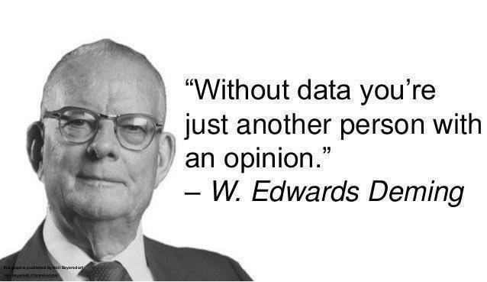
Regression models

Slide 2
What we will learn
Why we use models
Intuition behind OLS regression
How to read a regression table and evaluate a model
Making predictions
Bonus: introduction to logit models

Slide 3

Why?

Slide 4
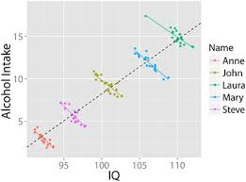
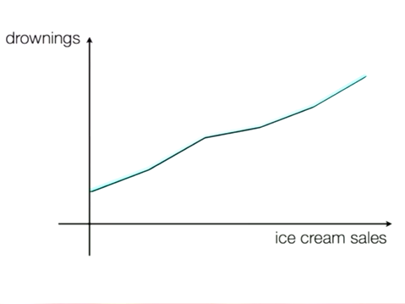
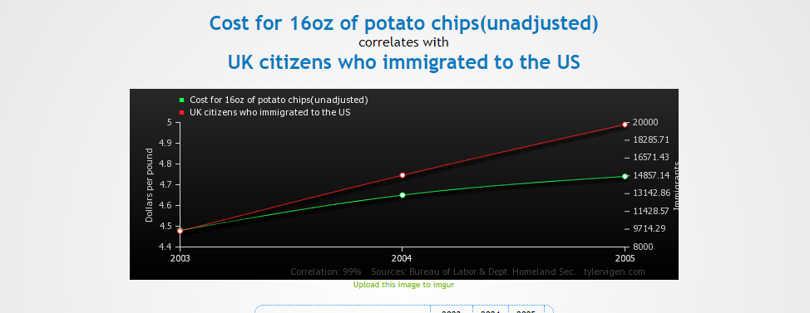
Spurious Correlation
Ministers’ salaries and the price of vodka
More doctors in a region -> more people dying from disease
The more you fundraise -> less likely to win a congressional race.
My own example at AccessLex: GPA change on bar passage

Slide 5

Intuition – Bivariate Regression

Slide 6
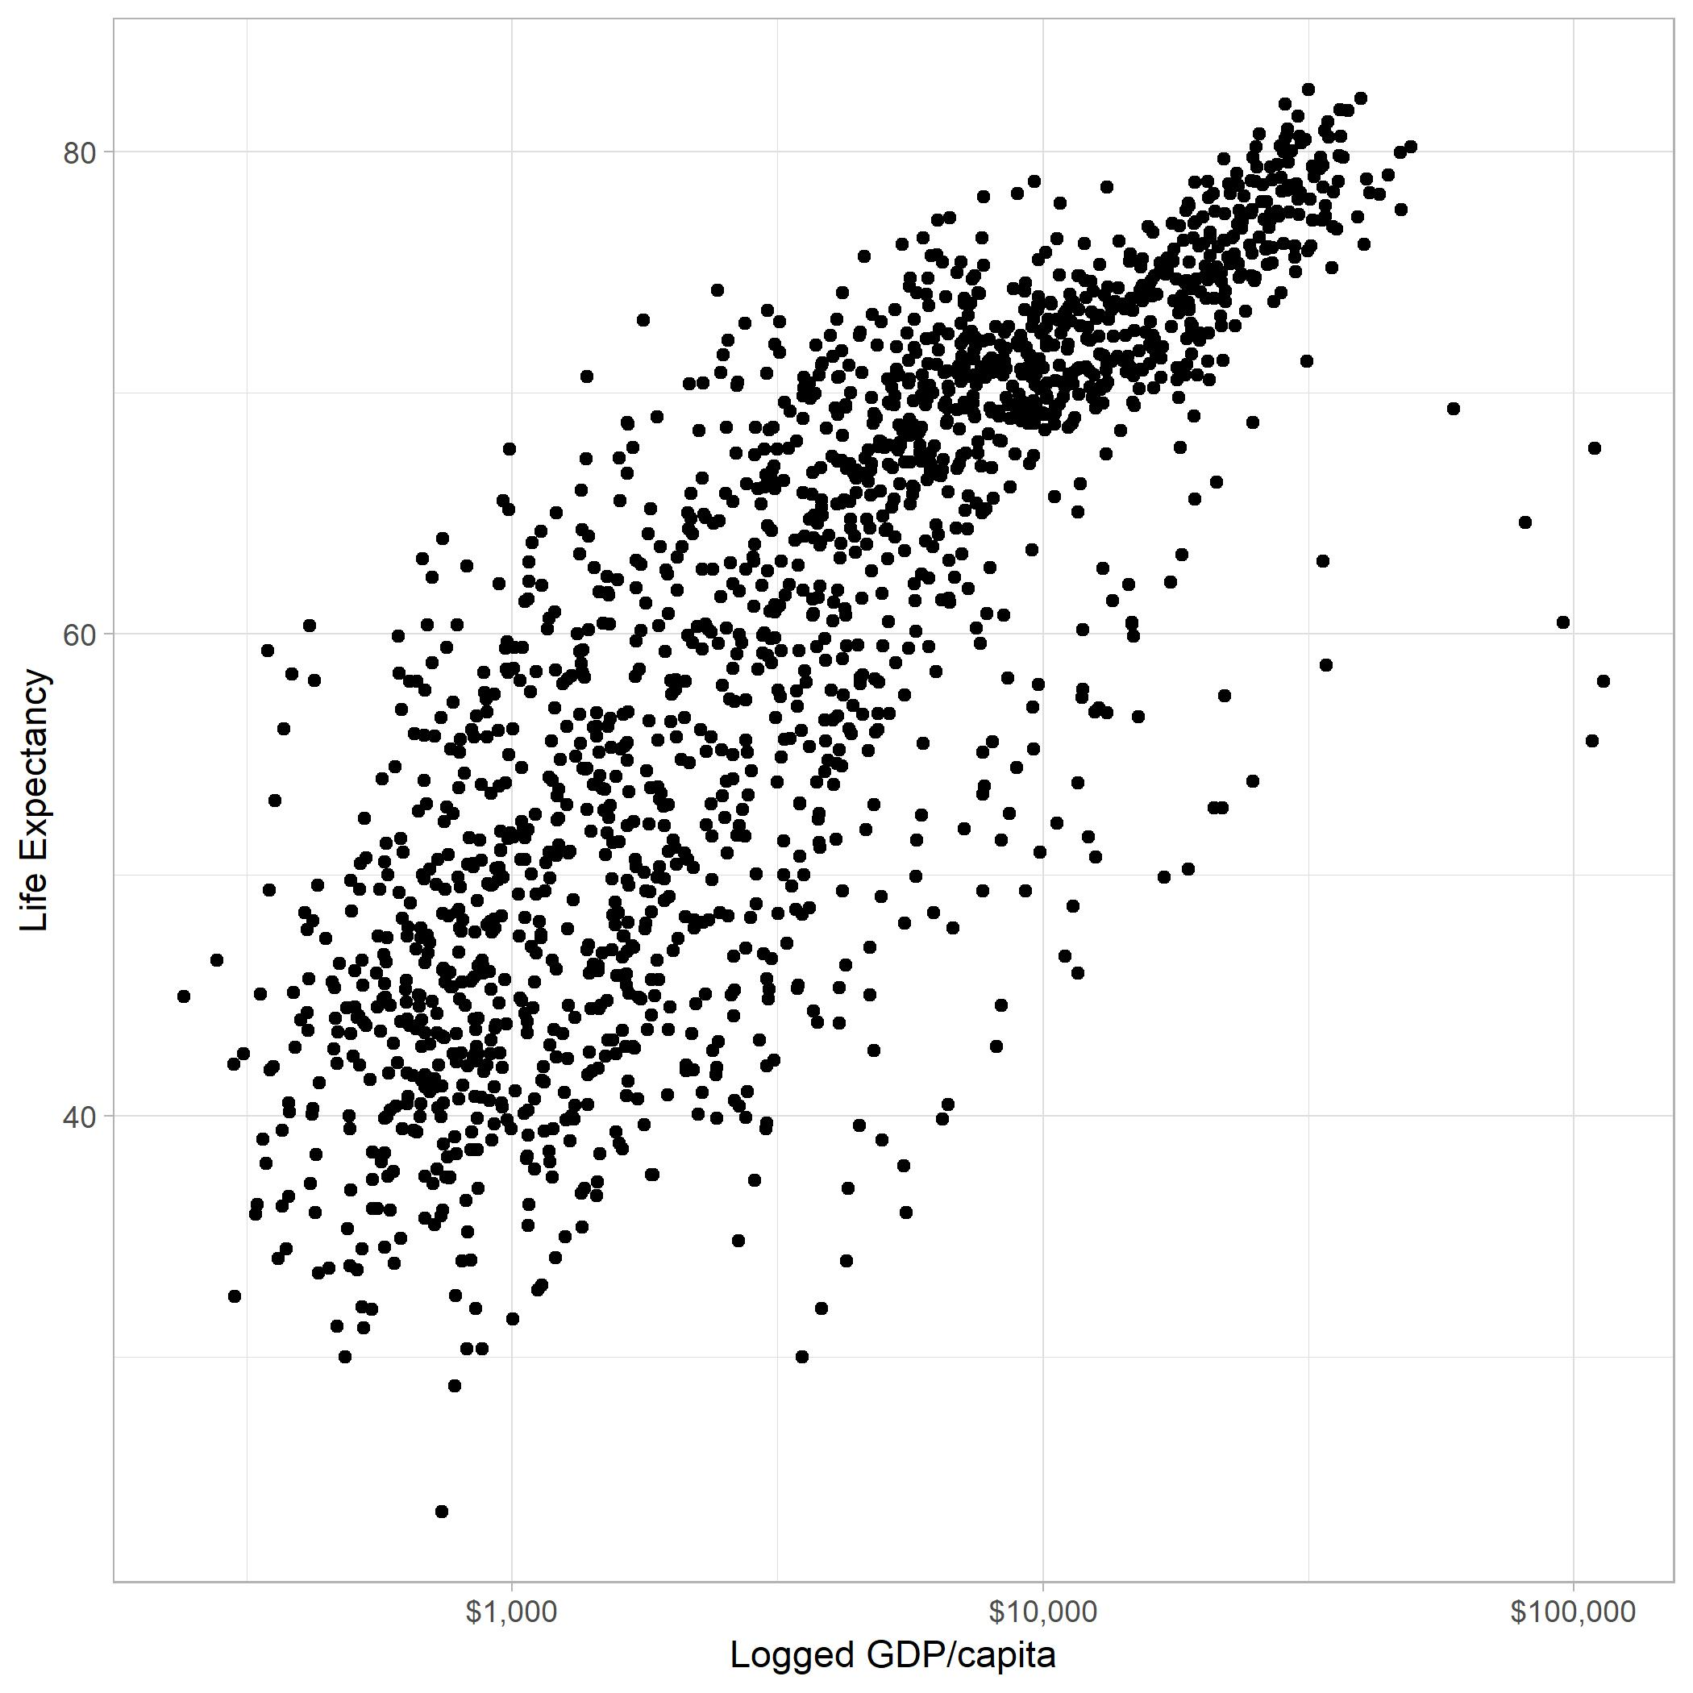
Someone draw me the line that best fits the data
Tell me about the theory?
What’s the Dependent Variable (DV) and Independent Variable (IV)?
Notes:
Also, we are inherently trying to cross hurdles 1-3 here.

Slide 7
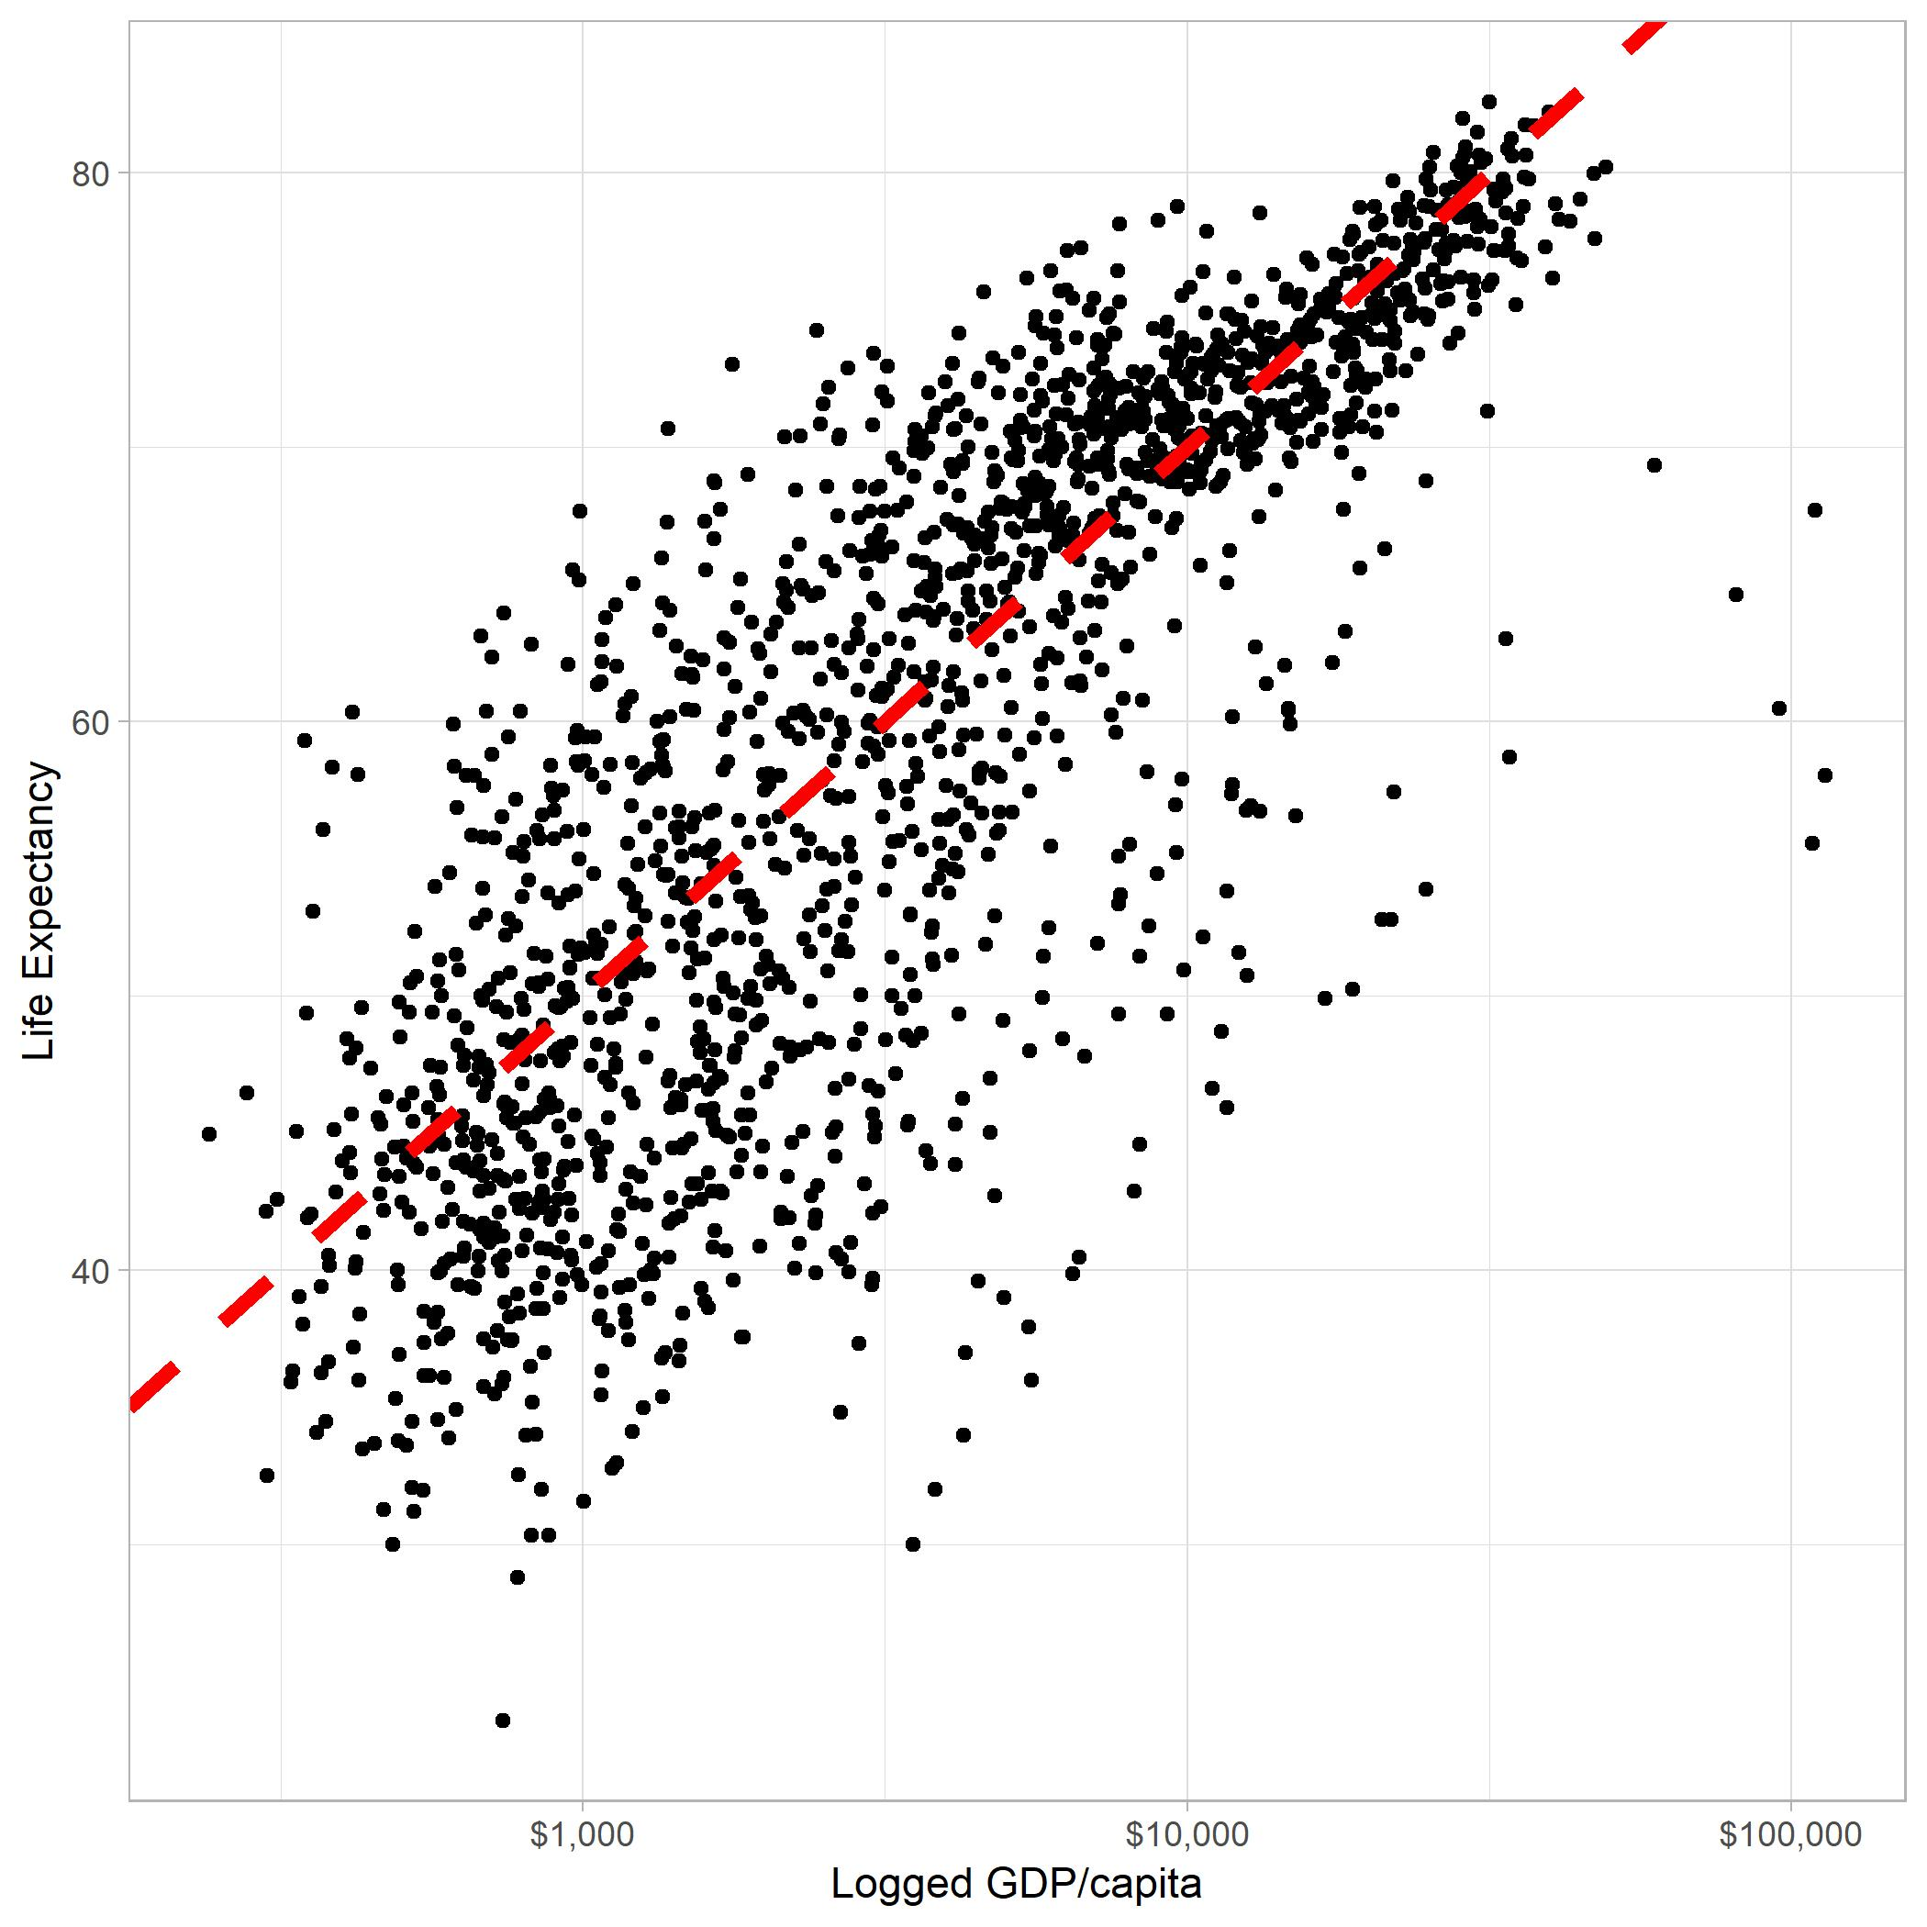
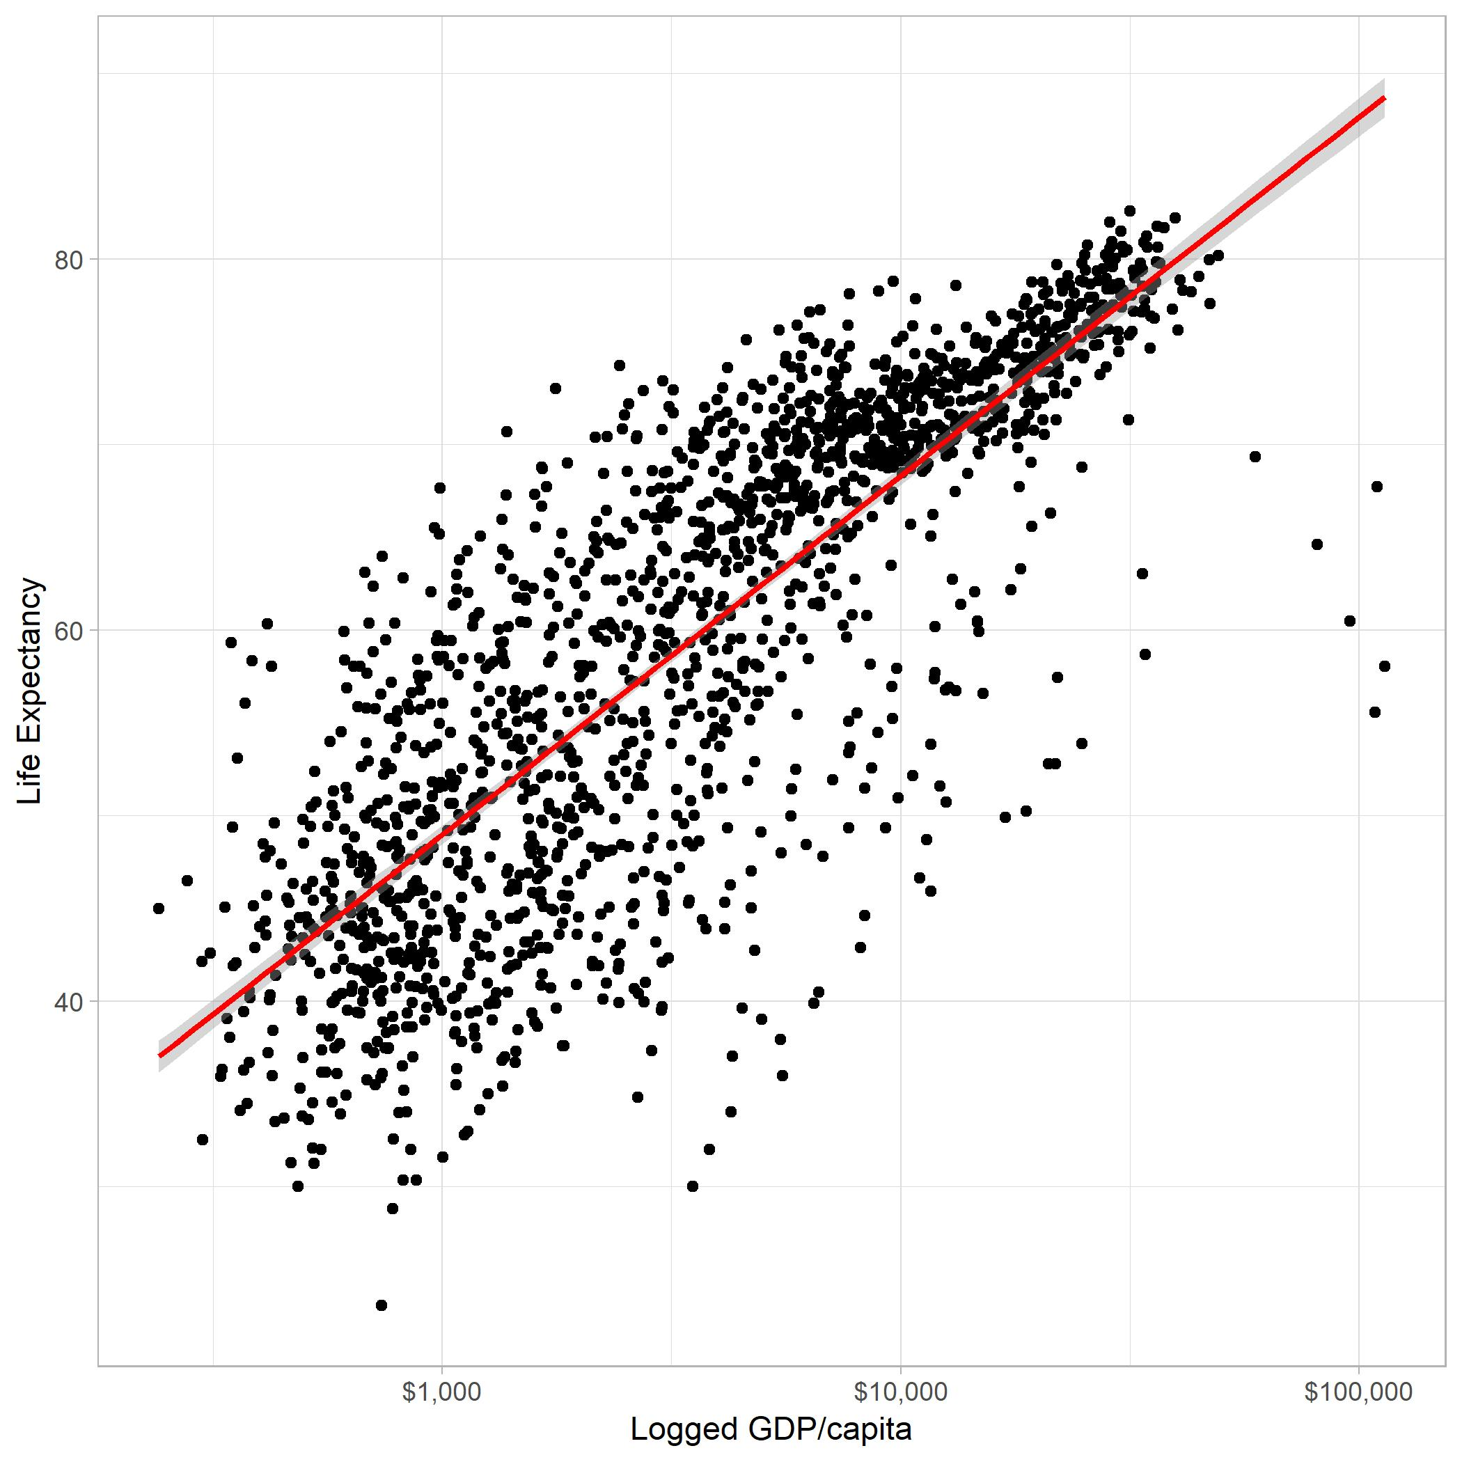
My Own Guess
Actual Regression Line

Slide 8
Interpretation
 | Dependent variable:
 | lifeExp
Logged GDP per Capita | 19.353***
 | (0.343)
Constant | -9.101***
 | (1.228)
Observations | 1,704
R² | 0.652
Adjusted R² | 0.652
Residual Std. Error | 7.620 (df = 1702)
F Statistic | 3,192.273*** (df = 1; 1702)
Note: | *p**p***p<0.01
For a one-unit increase in GDP per capita (logged), we expect life expectancy to increase by 19 years.
Is this the only factor that influences life expectancy?
What else can explain life expectancy?

Slide 9
Multiple Regression

Slide 10
“Controlling” for other factors
In any observational study, multiple regression is by far the most common method in the social sciences.
How do we “control for” the effects of other variables in Experiments?
Random Assignment

Slide 11
 | Dependent variable:
 | Life Expectancy
Logged GPD per Capita | 14.787***
 | (0.422)
Americas | 7.015***
 | (0.554)
Asia | 5.912***
 | (0.477)
Europe | 9.577***
 | (0.604)
Oceania | 9.213***
 | (1.536)
Constant | 2.317*
 | (1.359)
Observations | 1,704
R² | 0.704
Adjusted R² | 0.703
Residual Std. Error | 7.038 (df = 1698)
F Statistic | 807.634*** (df = 5; 1698)
Note: | *p**p***p<0.01
Multiple Regression on Gas Mileage

Slide 12
 | Dependent variable:
 | Life Expectancy
Logged GDP per Capita | 14.787***
 | (0.422)
Americas | 7.015***
 | (0.554)
Asia | 5.912***
 | (0.477)
Europe | 9.577***
 | (0.604)
Oceania | 9.213***
 | (1.536)
Constant | 2.317*
 | (1.359)
Observations | 1,704
R² | 0.704
Adjusted R² | 0.703
Residual Std. Error | 7.038 (df = 1698)
F Statistic | 807.634*** (df = 5; 1698)
Note: | *p**p***p<0.01
Influence of GDP per Capita while controlling for Continent
Simultaneously, “Asia” tells us the difference of living in Asia, compared to Africa, while controlling for logged GDP per Capita

Slide 13
 | Dependent variable:
 | Life Expectancy
Logged GDP per Capita | 14.787***
 | (0.422)
Americas | 7.015***
 | (0.554)
Asia | 5.912***
 | (0.477)
Europe | 9.577***
 | (0.604)
Oceania | 9.213***
 | (1.536)
Constant | 2.317*
 | (1.359)
Observations | 1,704
R² | 0.704
Adjusted R² | 0.703
Residual Std. Error | 7.038 (df = 1698)
F Statistic | 807.634*** (df = 5; 1698)
Note: | *p**p***p<0.01
For every unit increase in GDP per capita, we expect an increase in life expectancy of 14.8 years, regardless of continent.
Simultaneously, we expect that countries in Asia will have a life expectancy that is 5.9 years longer than countries in Africa.
This is the key to crossing our fourth causal hurdle.
What does “Constant” (intercept) mean?
Notes:
Explain how to understand categorical variables versus continuous variables.

Slide 14
Let’s practice (team up)
Explain the coefficients to each other
Predictors of First-Year Law School GPA
Variable | Coefficients | P-Value
Undergraduate GPA | 0.336 | 0.001*
LSAT Score | 0.039 | 0.001*
Male | 0.034 | 0.595
White | 0.052 | 0.585
Intercept | -4.248 | 0.001*
Number of Observations: 104 |  | R²: 0.357
* indicates significance at 0.1 level

Slide 15

Things to consider

Slide 16
“But is it significant?” ------------------ P-Values
Easily one of the more difficult concepts for people to grasp (almost always an essay question on my exams).
P-values are the most common statistical tool to evaluate a hypothesis. Closest thing to a “bottom line” in statistics.
Likelihood of getting our result, if there was truly no relationship. Ranges from 0 to 1.
A p-value of .9 would indicate that there is a 90 percent chance of showing this trend if there was truly no relationship.
Very likely that there is NO relationship
A p-value of 0.05 would indicate there is a five percent probability of observing the outcome if there were no relationship.
Very likely to mean there is a relationship

Slide 17
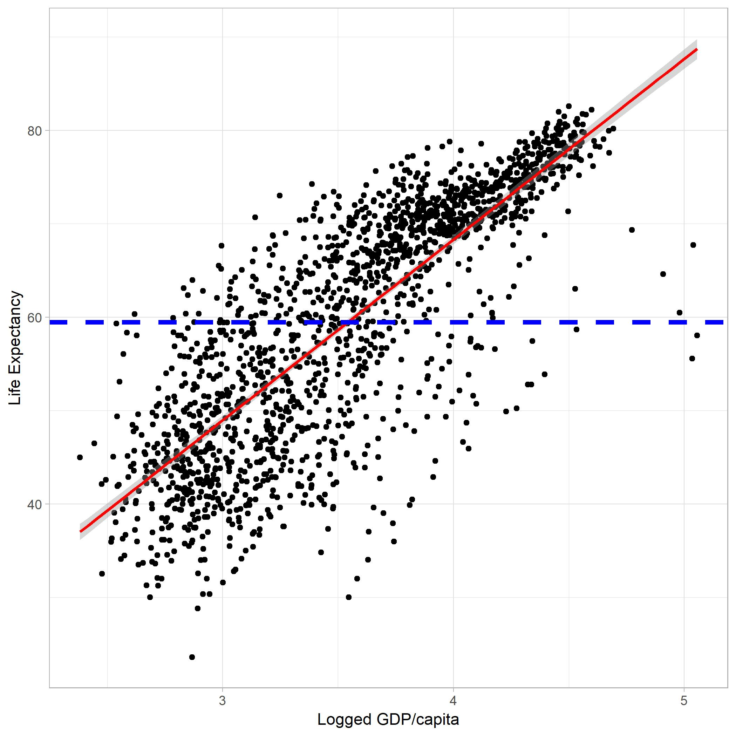
Understanding P-Values
Visually, how likely is it that we got the red line when in reality the true relationship is the blue line?
In social science, common levels include 0.1, 0.05, and 0.01.
To help, sometimes researchers will put a symbol to let you know if something is significant (“*”, “†”).
You are looking for numbers BELOW these cutoff points (0.03 is less than 0.05).

Slide 18
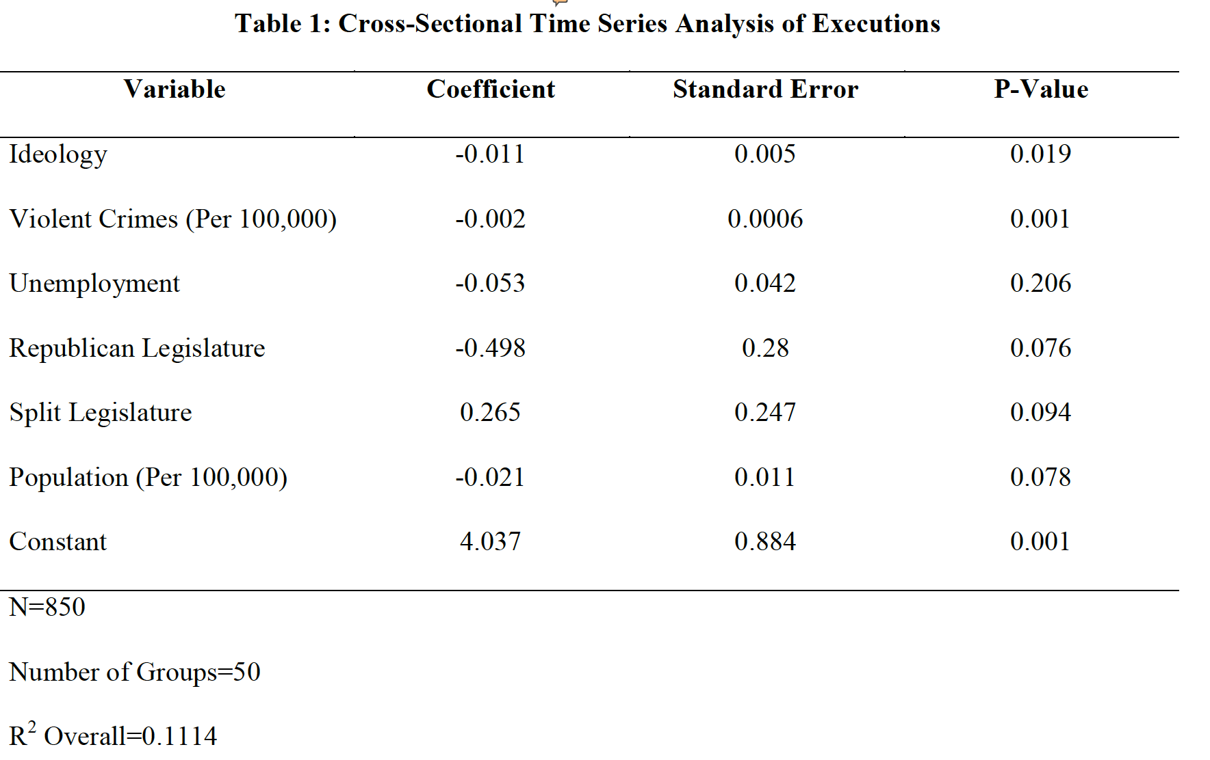
Practice: Which variables are significant at 0.1, 0.05, and 0.01 level?
For variables significant at the 0.05 level, interpret the coefficients.

Slide 19
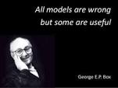
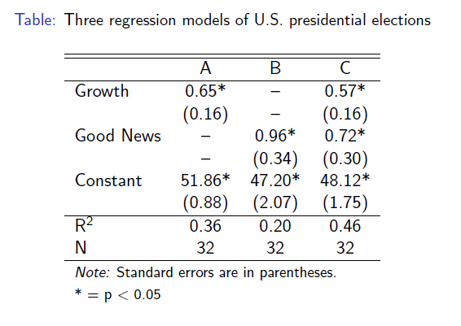

Goodness of fit (how good is our model?)
$R^{2}$ is a popular indicator of a model’s performance.
$R^{2}$ ranges from 0 to 1 (0 meaning no relationship, 1 meaning a perfect relationship).
Question: What is a good/bad value for $R^{2}$?
No single answer.
$R^{2}$ is best used as a comparison on similar models.
Which model is the best?

Slide 20
Statistical v. substantive significance
Are the effects found in our model “big?”
It's tempting to answer, “Well of course they’re big. Both coefficients are statistically significant. Therefore, they’re big." That logic, although perhaps appealing, is faulty.
Math (that doesn’t need explaining here) makes it so that the larger the sample, the easier it is to get statistical significance.
But don't mistake this for a big substantive impact.
More of a judgement call that requires knowledge of the field.
Notes:
Big sample sizes make for small standard errors, and hence larger t-statistics, and hence a greater likelihood of statistical significance.
Andrew had a number of schools where we found statistical significance, but the effect of the variable was tiny.

Slide 21
Things to consider when looking at a Regression output
What is the dependent variable?
What are the independent variables?
How many observations are included?
Which variables are statistically significant?
Of the statistically significant variables, which ones are substantively significant?
How well does the overall model perform?

Slide 22
Practice - DV? - IVs? - # of observations? - Statistically Significant? - Substantively Significant? - Model Performance?
Let’s Practice Together

Slide 23
Practice - DV? - IVs? - # of observations? - Statistically Significant? - Substantively Significant? - Model Performance?
Your Turn
Predictors of First-Year Law School GPA
Variable | Coefficients | P-Value
Undergraduate GPA | 0.336 | 0.001*
LSAT Score | 0.039 | 0.001*
Male | 0.034 | 0.595
White | 0.052 | 0.585
Intercept | -4.248 | 0.001*
Number of Observations: 104 |  | R²: 0.357
* indicates significance at 0.1 level

Slide 24
Predictors of First-Year Law School GPA
Variable | Coefficients | P-Value
UGPA | 0.336 | 0.001*
LSAT Score | 0.039 | 0.001*
Male | 0.034 | 0.595
White | 0.052 | 0.585
Intercept | -4.248 | 0.001*
Number of Observations: 104 |  | R²: 0.357
* indicates significance at 0.1 level
Using the output from the tables here, we can actually make predictions. The formula using the previous table is as follows:
Predicted First Year GPA = 0.336(UGPA) + 0.039(LSAT) + 0.034(Male) + 0.052(White) – 4.248.
Note: the intercept (“constant”) is the expected value you would get if all of your Independent Variables were 0. This is almost never a substantively interesting coefficient, but necessary when making predictions like this.
What is the expected first year GPA for a white female student coming in with a 3.5 UGPA and an LSAT of 153?
0.336(3.5) + 0.039(153) + 0.034(0) + 0.052(1) – 4.248 = 2.947

Slide 25
Bonus: Making predictions Get in groups of 2 and make a prediction.
Predictors of First-Year Law School GPA
Variable | Coefficients | P-Value
Undergraduate GPA | 0.336 | 0.001*
LSAT Score | 0.039 | 0.001*
Male | 0.034 | 0.595
White | 0.052 | 0.585
Intercept | -4.248 | 0.001*
Number of Observations: 104 |  | R²: 0.357
* indicates significance at 0.1 level

Slide 26
Logit Models – A Sneak Peak
OLS regression only works under a set of strict assumptions.
One assumption is that the dependent variable is continuous (GPAs).
What happens when our dependent variable is limited?
Bar Passage: Pass/Fail
Admitted to law school: Yes/No
Took out loans, didn’t take out loans
For dichotomous dependent variables (2 outcomes) you need either a logit/probit model
Requires slightly different interpretation

Slide 27
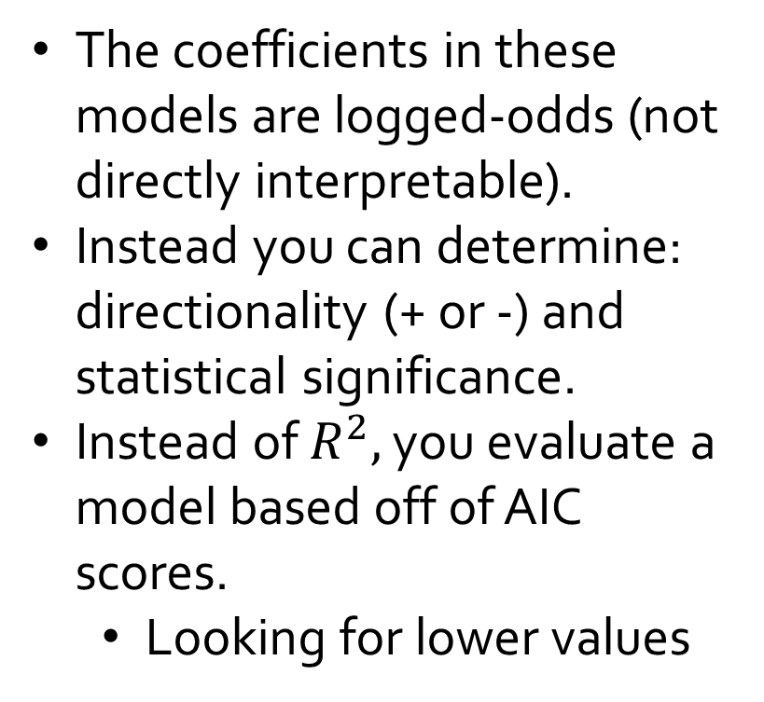
Table B2: Examination of Bar Passage with Engagement Indicators
Variable | Coefficient
 | (P-Value)
White | 0.581
 | (0.440)
Male | -1.055
 | (0.177)
LSAT Score | -0.009
 | (0.905)
Undergraduate GPA | -0.6
 | (0.526)
Final GPA | 8.043*
 | (0.001)
Credit Hours: Doctrinal Bar | 0.178*
 | (0.027)
Credit Hours: Skill | 0.083
 | (0.448)
Learning to Think Like a Lawyer | 0.034
 | (0.407)
Student-Faculty Interaction | 0.057
 | (0.297)
Student Advising | 0.009
 | (0.789)
International Student | -3.875*
 | (0.016)
Financial Counseling | -0.952*
 | (0.025)
School Dummy Variable | -0.352
 | (0.713)
Intercept | -22.961*
 | (0.070)
Observations | 148
Log Likelihood | -28.772
Akaike Inf. Crit. | 85.545
* indicates statistical Significance
The coefficients in these models are logged-odds (not directly interpretable).
Instead you can determine: directionality (+ or -) and statistical significance.
Instead of $R^{2},$ you evaluate a model based off of AIC scores.
Looking for lower values

Slide 28
Table B2: Examination of Bar Passage with Engagement Indicators
Variable | Coefficient
 | (P-Value)
White | 0.581
 | (0.440)
Male | -1.055
 | (0.177)
LSAT Score | -0.009
 | (0.905)
Undergraduate GPA | -0.6
 | (0.526)
Final GPA | 8.043*
 | (0.001)
Credit Hours: Doctrinal Bar | 0.178*
 | (0.027)
Credit Hours: Skill | 0.083
 | (0.448)
Learning to Think Like a Lawyer | 0.034
 | (0.407)
Student-Faculty Interaction | 0.057
 | (0.297)
Student Advising | 0.009
 | (0.789)
International Student | -3.875*
 | (0.016)
Financial Counseling | -0.952*
 | (0.025)
School Dummy Variable | -0.352
 | (0.713)
Intercept | -22.961*
 | (0.070)
Observations | 148
Log Likelihood | -28.772
Akaike Inf. Crit. | 85.545
* indicates statistical Significance
Practice - DV? - IVs? - # of observations? - Statistically Significant? - Substantively Significant? - Model Performance?
Notes:
Model performance is kind of a trick question because it is really only good for comparing. There is no inherent benchmark to compare it with.

Slide 29

Thank you!

